Slide 1

Voltage Regulator
By Jatasya Raval

Slide 2
What is 7805 Voltage Regulator IC?
The voltage source in a circuit may have fluctuations and would not give the fixed voltage output.
It is a member of the 78xx series of fixed linear voltage regulator ICs.
The Voltage Regulator IC maintains the output voltage at a constant value.
The xx in 78xx indicates the fixed output voltage. 7805 provides a +5V regulated power supply.

Slide 3
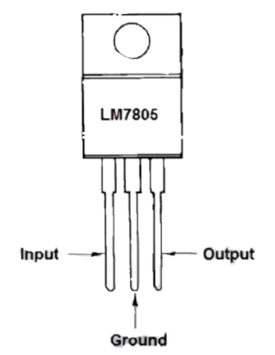
7805 Pin Diagram

Slide 4
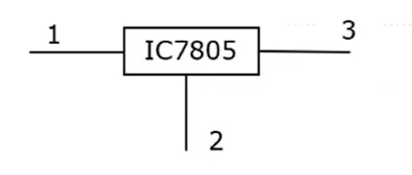
Circuit Symbol of the Voltage Regulator

Slide 5
Thank You

